Slide 1
Supervised Hashing for Image Retrieval via Image Representation Learning
Rongkai Xia, Yan Pan, Cong Liu (Sun Yat-Sen University)
Hanjiang Lai, Shuicheng Yan (National University of Singapore)
AAAI 2014

Slide 2
Motivation
In most existing methods, each image is firstly encoded by a vector of some handcrafted visual descriptor (e.g., GIST, BoW, SIFT)
Concern: the chosen hand-crafted visual features do not necessarily guarantee to accurately preserve the semantic similarities of image pairs.
e.g., a pair of semantically similar/dissimilar images may not have feature vectors with relatively small/large Euclidean distance.

Slide 3
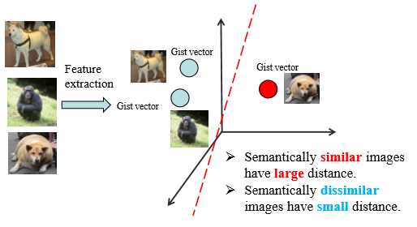
Motivation

Slide 4
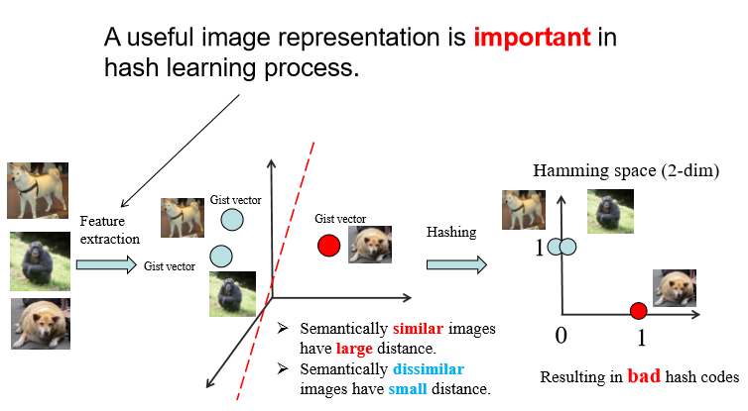
Motivation

Slide 5
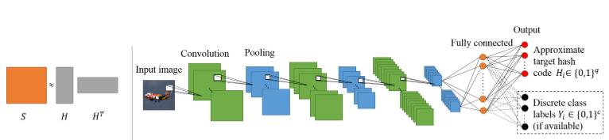
The Proposed Approach

Slide 6
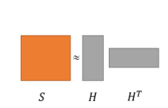
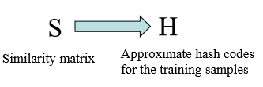
Stage1

Slide 7
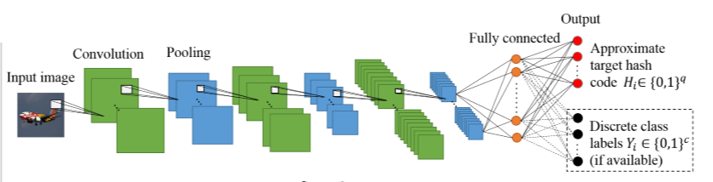
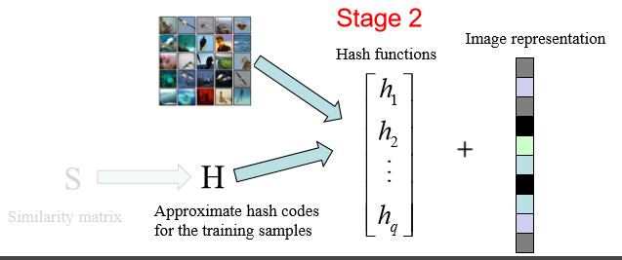

Slide 8
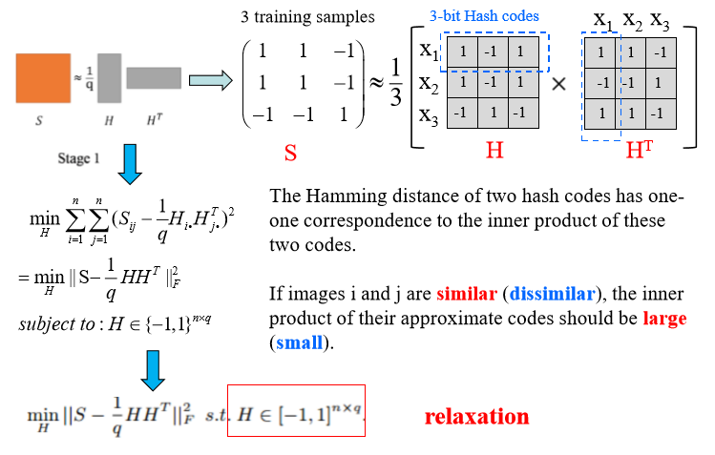
Stage1：Learning Approximate Codes

Slide 9
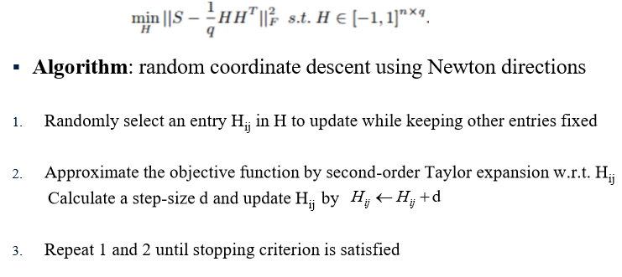
Optimization

Slide 10
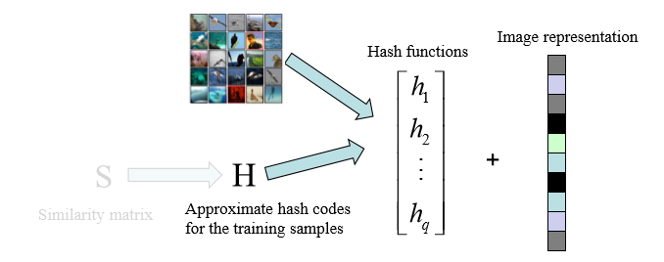
Stage2：Learning Hash Functions
• It is a multi-label binary classification problem that is solved by deep convolutional neural networks.
• It leans hash functions as well as image features.
• We propose two methods: CNNH and CNNH+.

Slide 11
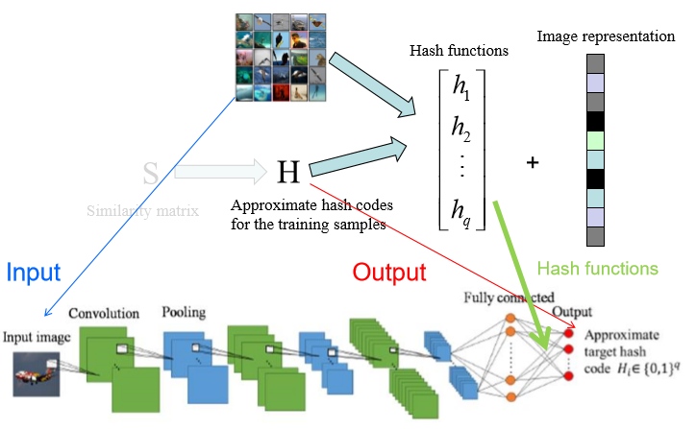
Method1：CNNH

Slide 12
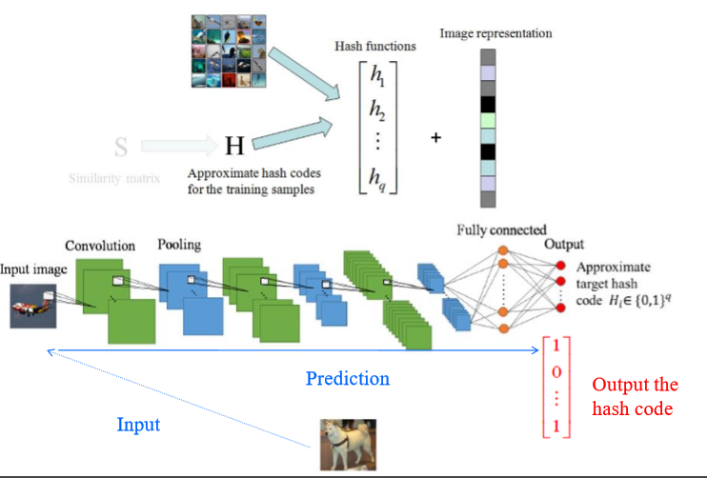
Method1：CNNH

Slide 13
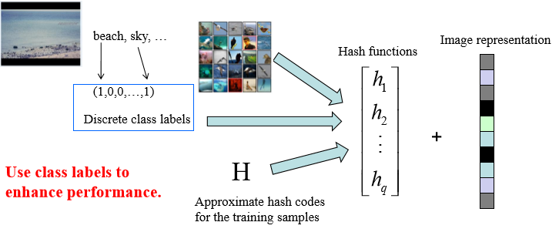
Methods：CNNH+

Slide 14
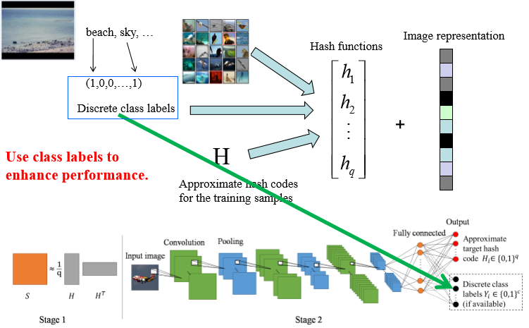
Method2：CNNH+

Slide 15
Experiment
1.adopt the architecture of [Krizhevsky, NIPS 2012] as our basic framework.
2.network has three convolutional-pooling layers with rectified linear activation, max pooling and local contrast normalization, a standard fully connected layer, and an output layer with softmax activation.
3.use 32, 64, 128 filter (with the size 5*5) in the 1st, 2nd and 3rd convolutional layer, respectively.
4.use dropout with a rate of 0.5.

Slide 16
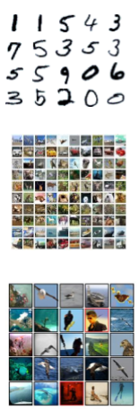
Datasets
MNIST: 70,000 greyscale images (in size 28*28) of handwritten digits from ‘0’ to ‘9’
CIFAR10: 60,000 color tinny images (in size 32*32) that are categorized in 10 classes
NUS-WIDE: about 270,000 images collected from the web. It is a multi-label dataset.

Slide 17
Baseline
LSH [Gionis et al. VLDB,1999]
SH [Weiss and Torralba. NIPS,2008]
ITQ [Gong and Lazebnik. CVPR,2011]
MLH [Norouzi and Blei. ICML,2011]
BRE [Kulis and Darrell. NIPS,2009]
ITQ-CCA [Gong and Lazebnik. CVPR,2011]
KSH [Liu et al. CVPR,2012]

Slide 18
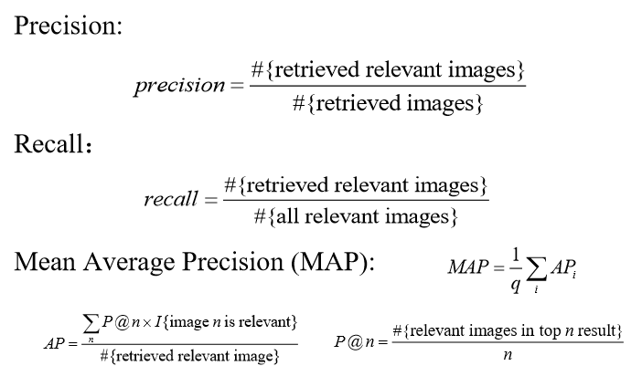
Evaluation Metrics

Slide 19
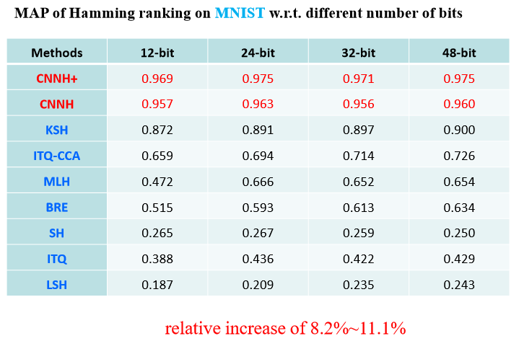
Results

Slide 20
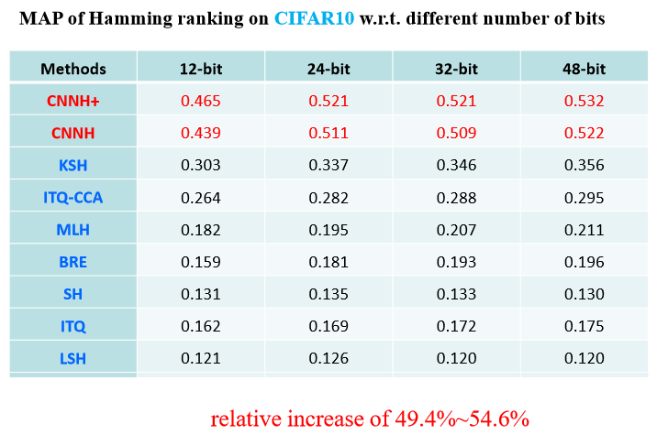
Results

Slide 21
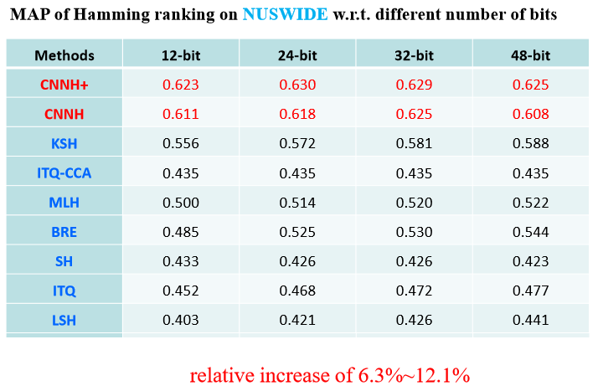
Results

Slide 22
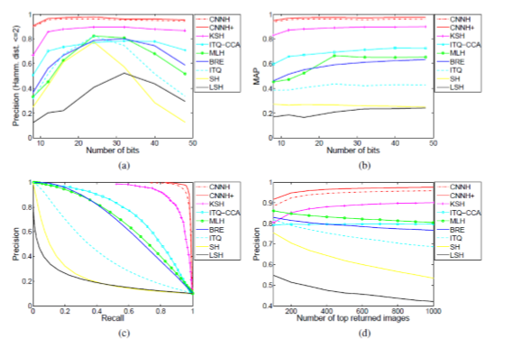
Results
Results on MNIST
(a) precision within curves Hamming radius 2 (b) MAP curves within Hamming radius 2 (c) precision-recall curves with 48 bits (d) precision curves with 48 bits

Slide 23
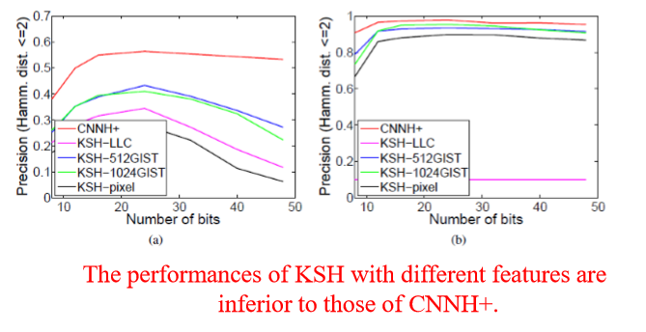
Results
CNNH+ vs. KSH with different hand-crafted features
(a) Results on CIFAR-10 (b) Results on MNIST

